Slide 1
Common Form Widgets
Check Box | Radio Buttons | Drop-Down Menu | List Box | Buttons | Password Field | Field Set
Notes:
Welcome to our lecture on Common Form widgets. In this lecture we will go through the following common form widgets like check box, radio button, drop down menu, list box, buttons, password fields, and field set. Let’s start the lecture.

Slide 2
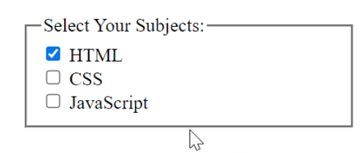
Check Box
Checkbox: Input with type="checkbox" for selecting values; uses boolean checked attribute.
Data: Sends name and value if selected; default value is "on."
Best Practice: Use labels for better usability.
Notes:
A checkbox is an input element with type set to checkbox, used to select values. The checked attribute is a boolean that makes the checkbox selected when present. If selected, the browser sends the name and value to the server, with a default value of on if no value is set. Use label elements with checkboxes to improve usability by allowing users to click the label to toggle the checkbox.

Slide 3
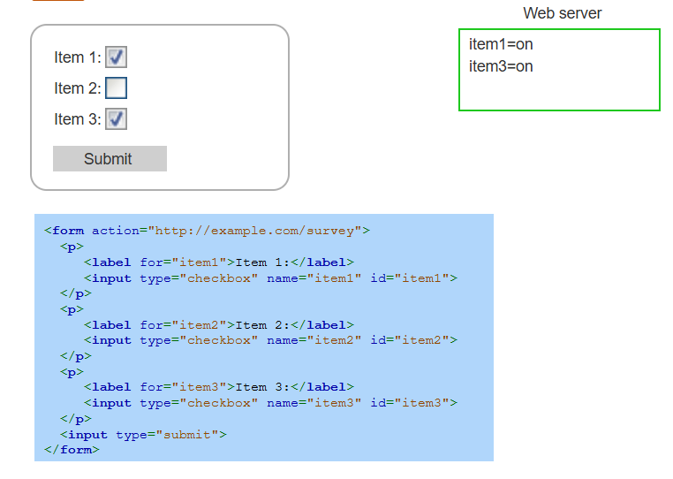
Check Box Example
Notes:
This example shows a form with checkboxes. Each checkbox has a label for usability and uses the name attribute to identify its data. When the form is submitted, selected checkboxes send their names and values to the server. In this case, Item 1 and Item 3 are selected, so the server receives item1 as on and item3 as on. Unselected checkboxes, like Item 2, do not send data.

Slide 4
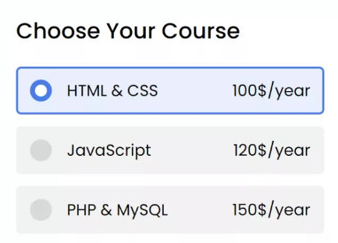
Radio Button
Radio Button: Input with type="radio" for selecting one value in a group.
Data: Sends the selected button's name and value to the server.
Difference: Only one radio button can be selected per group, unlike checkboxes.
Notes:
Next widget is radio button. Radio buttons are input elements with type set to radio, allowing users to select one value from a group. The selected button's name and value are sent to the server upon submission. Unlike checkboxes, only one radio button can be selected within a group, ensuring a single choice is made by the user.

Slide 5
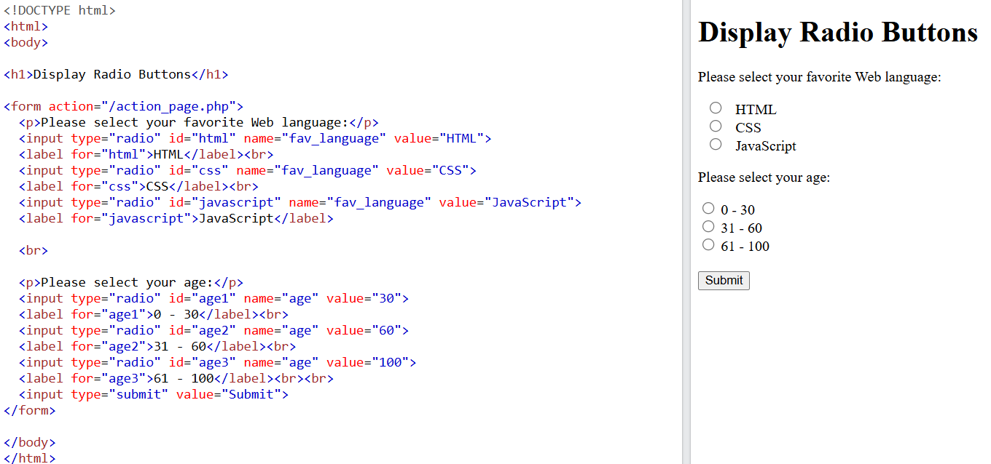
Form Submission Using Get Method
Notes:
This example demonstrates form submission using the GET method with radio buttons. Users select their favorite web language and age group from radio button options. Each group shares the same name attribute, ensuring only one option per group can be selected. The form data is appended as a query string to the URL when submitted, sending the selected name value pairs to the server for processing.

Slide 6
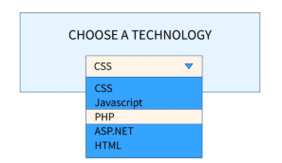
Drop-Down Menu
Select Element: Creates a drop-down menu for selecting predefined values.
Option Element: Defines individual selectable values in the menu.
Difference: Drop-down menus hide options until interacted with, unlike always-visible radio buttons.
Notes:
Next widget is drop down menu. A drop-down menu is created using the select element, allowing users to choose from predefined values. Each selectable value is defined using the option element. Unlike radio buttons, which display all options at once, drop-down menus keep options hidden until the user interacts with the menu. This makes drop-down menus more compact and useful for lists with many choices.

Slide 7
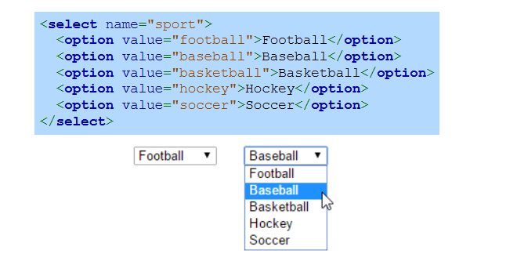
Drop-Down Menu Example
Notes:
This example shows a drop-down menu created with the select element. Each option in the menu is defined using the option element, with a value attribute for the data sent to the server. The user selects one option, such as Baseball, and the menu displays the selected value. Drop-down menus are useful for presenting multiple choices in a compact form, reducing the space needed on the page.

Slide 8
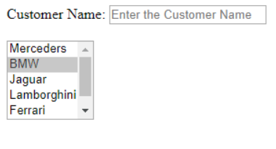
List Box
List Box: Use <select size="n"> to display multiple options with a scrollbar if needed.
Multiple Selection: Enabled with the multiple attribute; users hold Ctrl (Windows) or Command (Mac) to select multiple options.
Best Practice: Use checkboxes instead, as many users find multiple selection confusing.
Notes:
Next widget is list box. A list box is created using the select element with the size attribute to display multiple options at once, adding a scrollbar if needed. Multiple selection is enabled with the multiple attribute, allowing users to select multiple options by holding Ctrl on Windows or Command on Mac. Since many users find multiple selection confusing, it is recommended to use checkboxes for better usability.

Slide 9
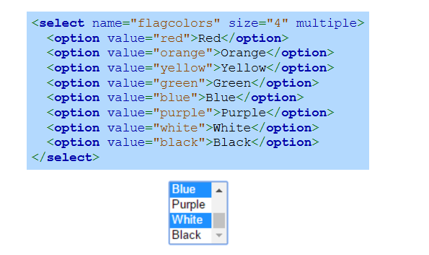
List Box Example
Notes:
This example shows a list box created using the select element with a size attribute of 4, allowing four options to be visible at once. The multiple attribute enables users to select multiple options simultaneously, such as Blue, Purple, White, and Black. Each option is defined using the option element with a value attribute, which is sent to the server upon form submission.

Slide 10
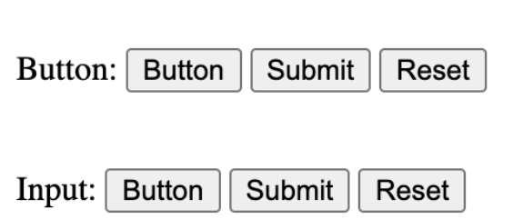
Buttons
Button Creation: Use <button> for text/images or <input type="button"> for text only.
Type Attribute: "Button" for JavaScript actions, "submit" for form submission.
Best Practice: Always specify the type to ensure consistent behavior across browsers.
Notes:
Next Widget is button. Buttons can be created using the button element for text and images or input with type set to button for text only. The type attribute specifies the button's purpose, such as button for JavaScript actions or submit for form submission. Always specify the type to ensure consistent behavior across different browsers. Buttons enhance form functionality and user interaction.

Slide 11
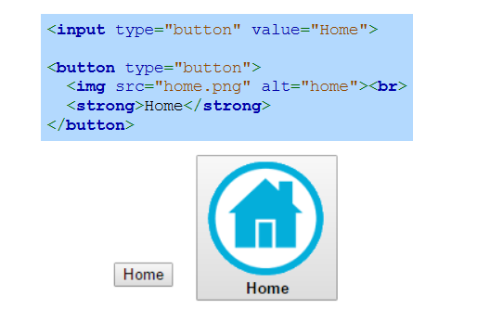
Buttons Example
Notes:
This example shows two buttons. The first button is created using an input element with type set to button and displays text only. The second button is created with the button element, allowing text and an image to be included. Using the button element provides more flexibility for styling and adding multimedia content, making it useful for creating visually rich buttons like the Home button in this example.

Slide 12
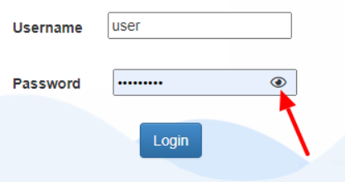
Password Field
Password Field: Input with type="password" hides entered text.
Security: Always use HTTPS for submitting sensitive data to ensure encryption.
Attributes: Use size to set width and maxlength to limit character entry.
Notes:
Our next widget is password field. A password field is created using an input element with type set to password, which hides the entered text. Always use HTTPS to securely encrypt sensitive data during form submission. The size attribute can be used to set the width of the field, and the max length attribute limits the number of characters the user can enter. These features ensure secure and user-friendly password input functionality.

Slide 13
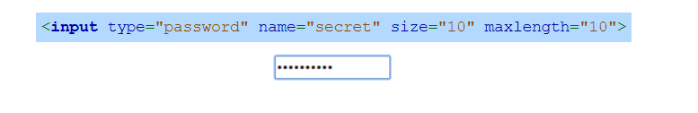
Password Field Example
Notes:
This example shows a password field created using the input element with type set to password. The name attribute identifies the field, while the size attribute sets the field's width to 10 characters. The max length attribute limits the input to a maximum of 10 characters. This ensures secure entry of hidden text and restricts the length of the password to maintain security and user input consistency.

Slide 14
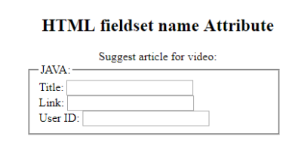
Fieldset
Fieldset: Groups related form widgets and adds a box around them.
Legend: Provides a caption for the fieldset.
Notes:
Finally we will discuss field set widget. The field set element is used to group related form widgets and visually organize them by adding a box around the group. The legend element provides a caption for the field set, offering context or a title for the grouped elements. This enhances the structure and readability of forms, making them more user-friendly and easier to understand. Field sets are useful for categorizing related input fields.

Slide 15
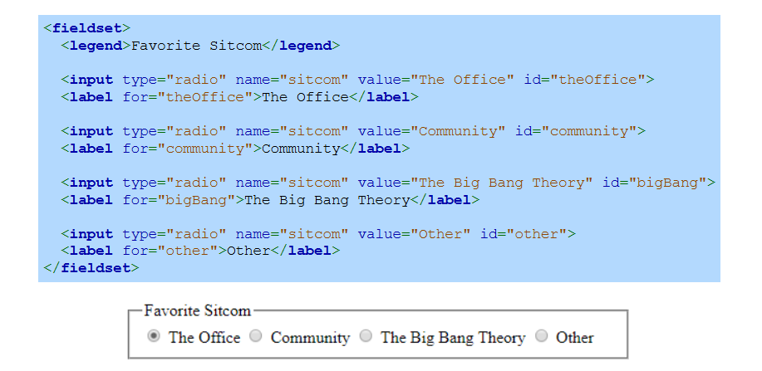
Fieldset Example
Notes:
This example demonstrates the field set element grouping related radio buttons under a single category. The legend element adds a caption, Favorite Sitcom, to describe the group. Each input element represents a radio button with labels linked via the for attribute. The name attribute groups the buttons, allowing only one selection. This structure improves form organization and usability for the user. Thanks for watching the lecture.

